Slide 1

Multi-Agent Deep Reinforcement Learning (MARL) in StarCraft 2
October 18th, 2018
Director: Guy Adam
Eiv Izyaev
Dor Hugi

Slide 2
Project Goals
Learning Reinforcement Learning
Experimenting with RL and MARL algorithms
Working with the new PySC2 environment
Solving real game problem with MARL

Slide 3
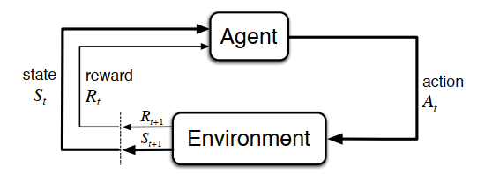
Reinforcement Learning
Sub-field of machine learning
Based on Interaction with environment
Major breakthroughs in recent years. Atari, Chess, Go
Classical Algorithms: Q learning, Actor-Critic

Slide 4


Q Learning
Off policy algorithm
Estimates $Q^{∗}$ optimal action-value function
Policy directly derived from $Q^{∗}$ → $A_{t}={argmax}_{a}\left(Q^{∗}\left(S_{t},a\right)\right)$

Slide 5

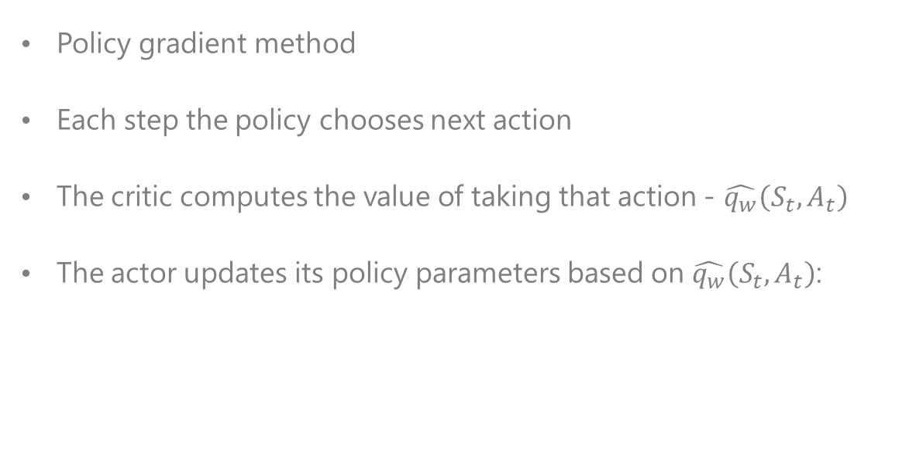
Actor-Critic
Policy gradient method
Each step the policy chooses next action
The critic computes the value of taking that action - $\hat{q_{w}}\left(S_{t},A_{t}\right)$
The actor updates its policy parameters based on $\hat{q_{w}}\left(S_{t},A_{t}\right)$:

Slide 6
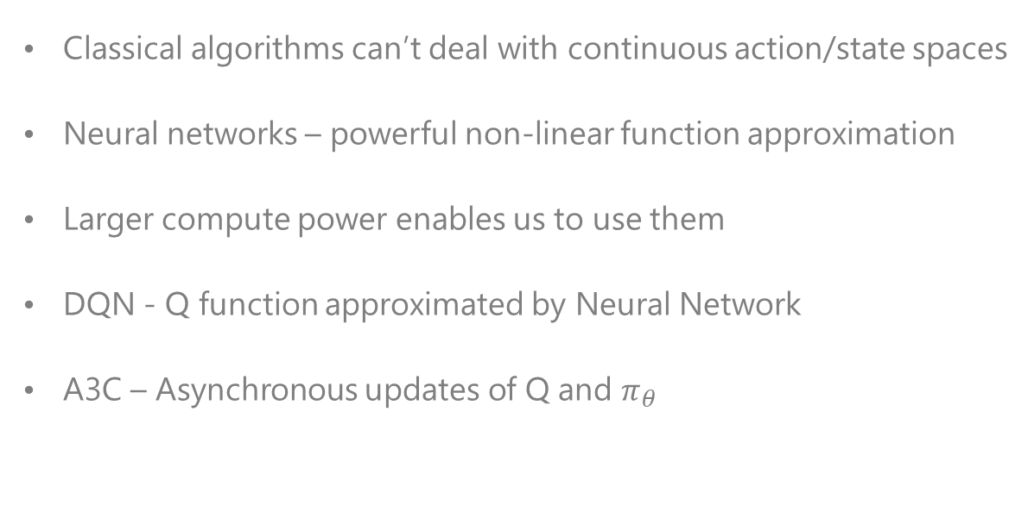
Deep Reinforcement Learning
Classical algorithms can’t deal with continuous action/state spaces
Neural networks – powerful non-linear function approximation
Larger compute power enables us to use them
DQN - Q function approximated by Neural Network
A3C – Asynchronous updates of Q and $π_{θ}$

Slide 7
Multi Agent Deep Reinforcement Learning
Classical algorithms don’t work well in MultiAgent environments
DQN is challenged by the non-stationarity of the environment
A3C suffers from increasing variance as number of agents grow
In the project we are trying to overcome those issues by introducing cooperation between the agents.

Slide 8
Brief History of StarCraft 2
Released in 2010 by Blizzard Entertainment
Continues the legacy of StarCraft Brood War
Highly competitive game
Large base of fans and professional players
National sport in South Korea

Slide 9

StarCraft2 Challenges
Multi agent environment, hundreds of different units
Imperfect information – Partially observed environment
“Fog-Of-War” – obscuring previously visited places
Large action space – approximately ${10}^{8}$ possibilities
Large state space
Delayed credit assignment

Slide 10
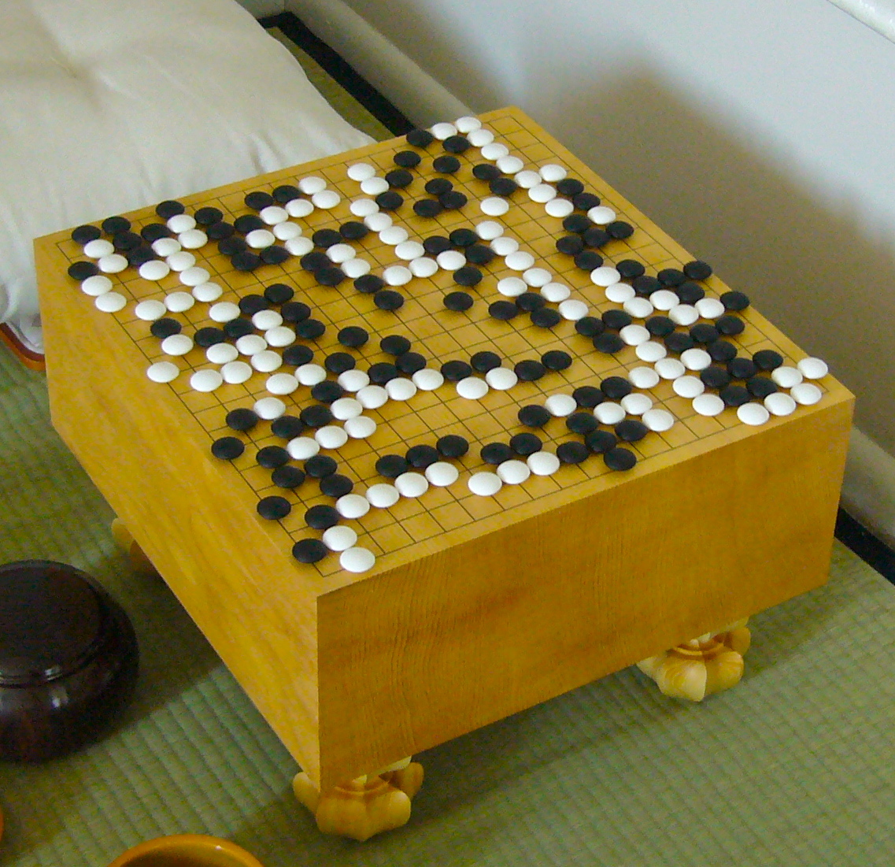
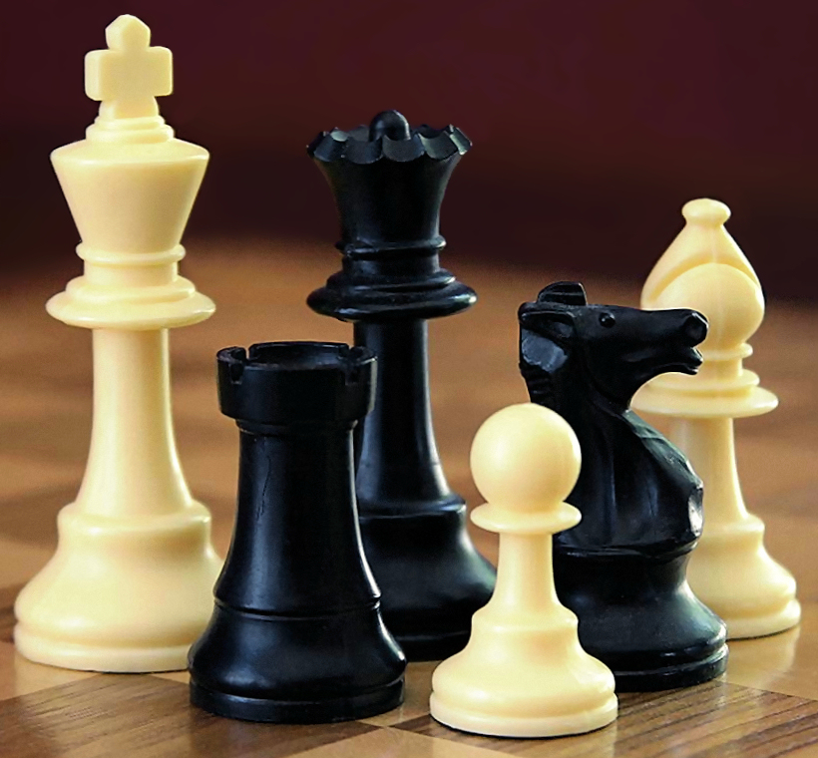
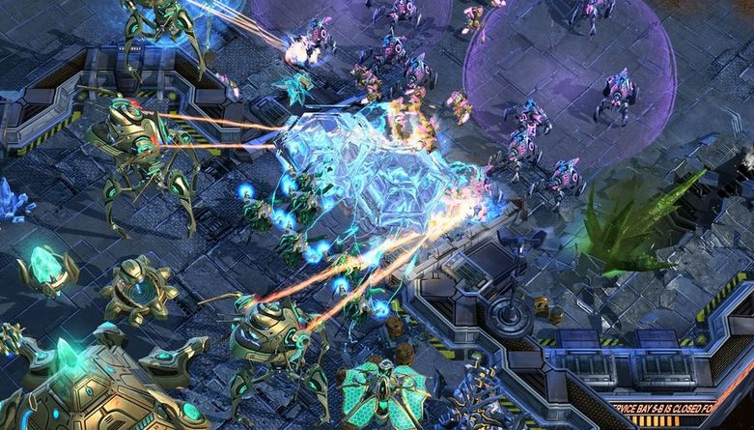

StarCraft2 Complexity
Chess ~${10}^{21}$
Go ~${10}^{300}$
StarCraft ~${10}^{2000}$

Slide 11
StarCraft2 API
Blizzard & DeepMind releasing API
Open source interface for communicating with the game engine
Enables researchers to “play” with the game environment
Full game solution seems far up the road
A set of mini-game scenarios were created for benchmarking
SC2 domain poses a grand new challenge for the RL community
Notes:
Bullet 1 – In order to enable research in the field of Reinforcement learning

Slide 12
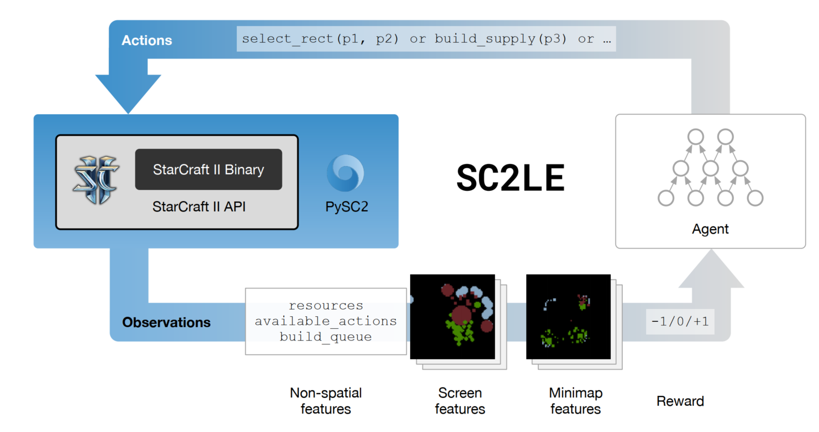
StarCraft2 API
Notes:
Bullet 1 – In order to enable research in the field of Reinforcement learning

Slide 13
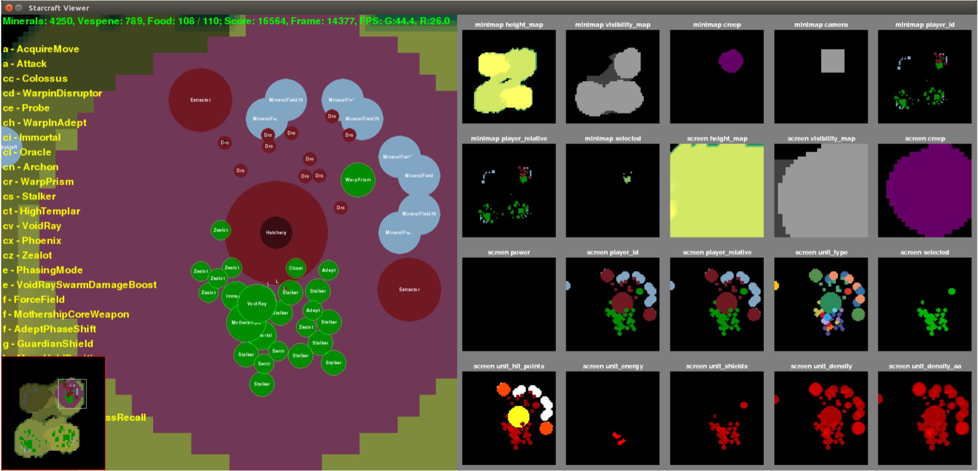
PySC2 viewer and feature set
Notes:
Bullet 1 – In order to enable research in the field of Reinforcement learning

Slide 14
Phase 1
The foundations
Self learning Reinforcement Learning domain
Focusing on a problem and coming up with a better solution
Reproduction and Experiment with different algorithms
Learning the PySC2 Environment
Learning the theory of Reinforcement learning
Filling the missing knowledge gap
Literature survey: DQN, A3C, Multiagent RL
“Playing” with simple RL environments

Slide 15
Phase 2
Hands on
Self learning Reinforcement Learning domain
Focusing on a problem and coming up with a better solution
Reproduction and Experiment with different algorithms
Learning the PySC2 Environment
Getting to know the details of the environment
Playing with the full-game as well as the mini-games
Trying random and pre-scripted agents
Develop simple Q-learning table based solution

Slide 16
Phase 3
The real challenge
Self learning Reinforcement Learning domain
Focusing on a problem and coming up with a better solution
Reproduction and Experiment with different algorithms
Learning the PySC2 Environment
Implementing standard algorithms
Using existing implementations as baseline
Reproducing DeepMind results (100M vs few K’s)
Focusing on single mini-map

Slide 17

DeepMind’s algorithm
Converges to local minimum:

Slide 18
Phase 4
Multi-Agent
Self learning Reinforcement Learning domain
Focusing on a problem and coming up with a better solution
Reproduction and Experiment with different algorithms
Learning the PySC2 Environment
Proposing our MARL solutions to overcome the challenges
Comparing our results to DeepMind’s architecture as a baseline

Slide 19
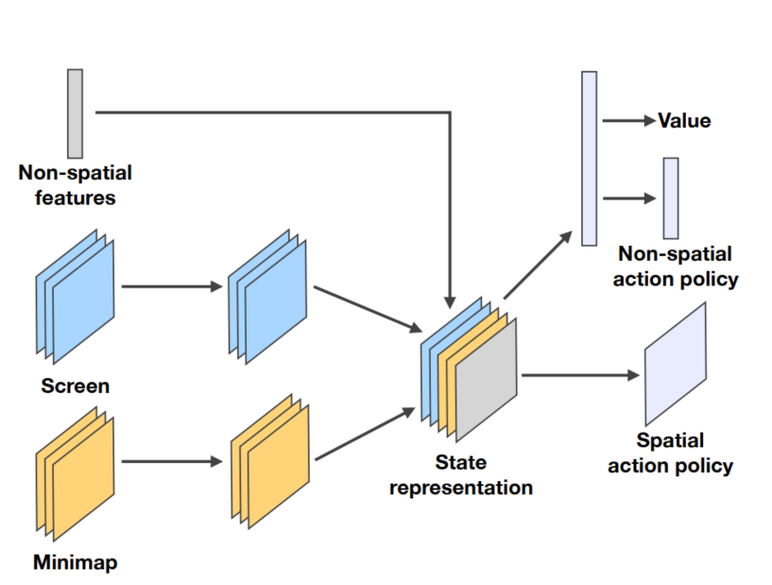
Baseline Solution A3C Based – Architecture:
Notes:
Bullet 1 – In order to enable research in the field of Reinforcement learning

Slide 20
Proposed solutions
Basic MultiAgent – Split agents such that each agent trains separately with standard A3C. Enables the network to adjust the weights better for each of the agents.
+Cooperation – Share the reward between the agents, enables them to maximize common objective by cooperation. Agents stop “cannibalizing” on each other rewards.
Notes:
Bullet 1 – In order to enable research in the field of Reinforcement learning

Slide 21
Proposed solutions
+Preprocessing – Add features as well as data preprocessing, such as: introducing each agent’s location, cleaning redundant information in order to have a lighter model thus faster training rates.
+Distance reward scaling – Agent’s reward scaled to distance between the agents, encouraging them to explore better. Punishing them for sticking to each other. Improving the results considerably.

Slide 22
Results
Agent | Mean | Max
Baseline A3C | 62 | 97
Basic MultiAgent | 63 | 99
+ Cooperation | 69 | 101
+ Preprocessing | 70 | 103
+ Distance reward scaling | 78 | 121

Slide 23
Video of our best agent

Slide 24
Summary
StarCraft2 is challenging environment for RL
API has serious inherent problems for MARL
Basic RL algorithms aren’t performing well even in simple maps
MultiAgent solutions improve performance considerably
Reinforcement learning is fun and interesting field
How else can you play a computer game for final project? ☺

Slide 25
Thank For Listening
Any questions?

